Slide 1
Configure Scale & Resilience

Slide 2
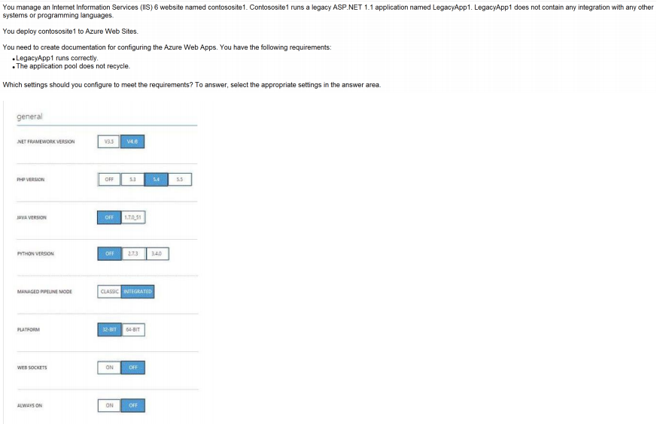
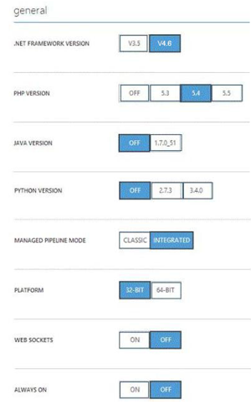
Ans =

Slide 3
Explanation:
* Managed Pipeline Mode. Sets the IIS pipeline mode. Leave this set to Integrated (the default) unless you have a legacy website that requires an older version of IIS *
Always on: ON Always On. By default, websites are unloaded if they are idle for some period of time.
This lets the system conserve resources. In Basic or Standard mode, you can enable Always On to keep the site loaded all the time. If your site runs continuous web jobs, you should enable Always On, or the web jobs may not run reliably.

Slide 4
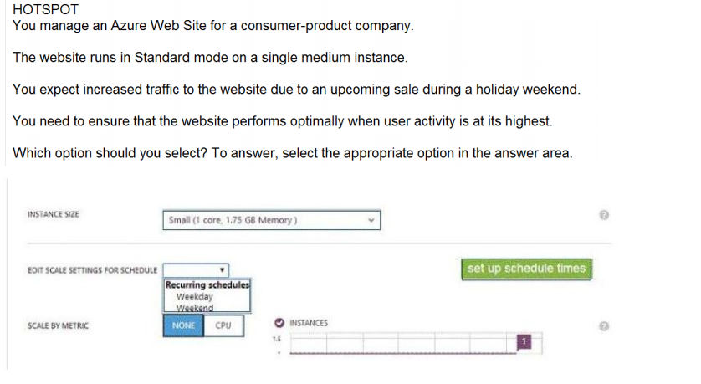
Ans =

Slide 5
Managing Hosting Plan

Slide 6
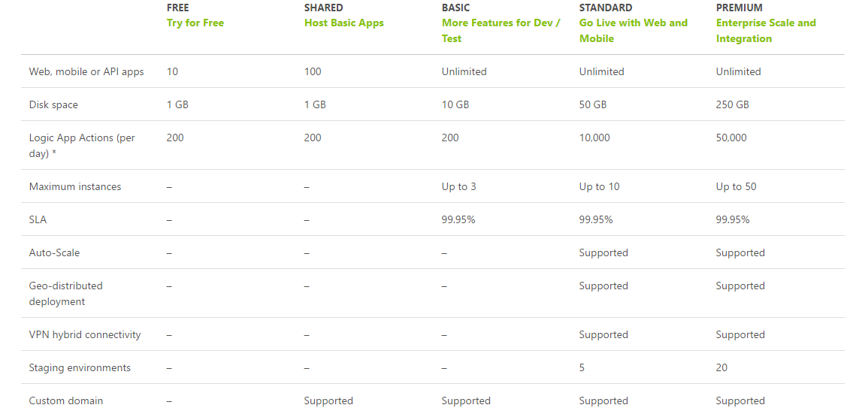

Slide 7
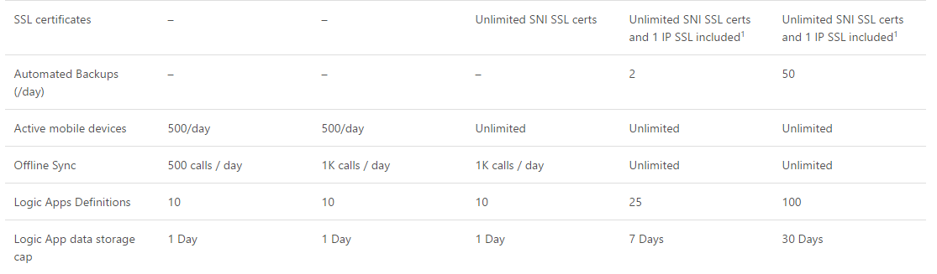

Slide 8
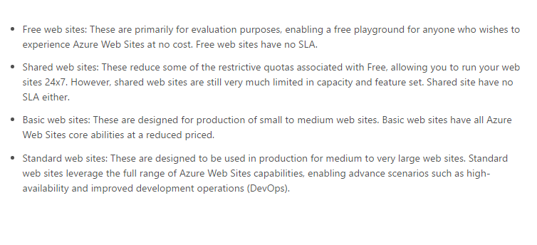

Slide 9
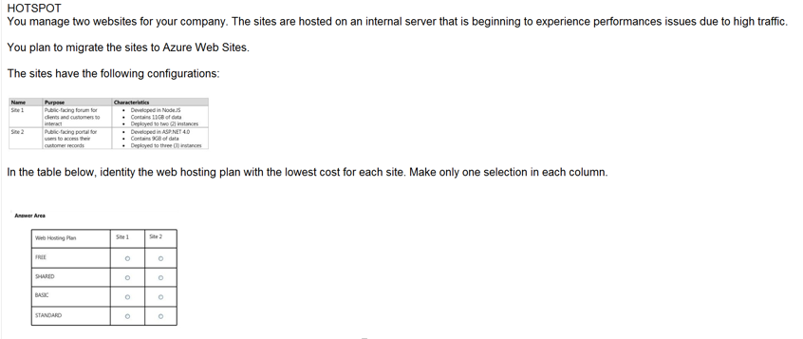
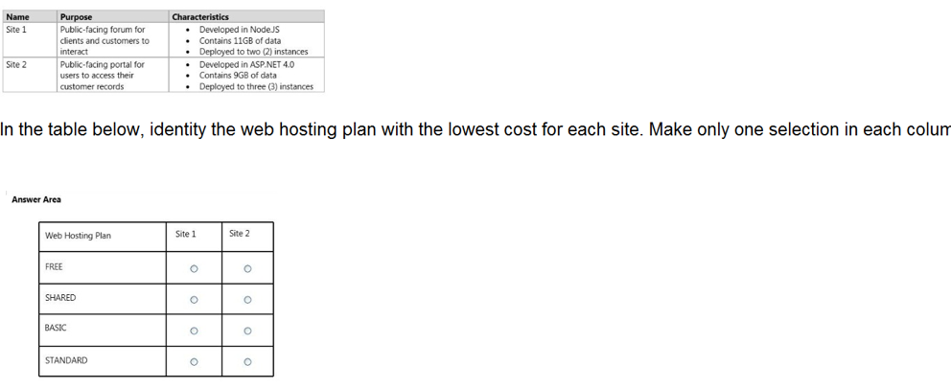
Ans =

Slide 10
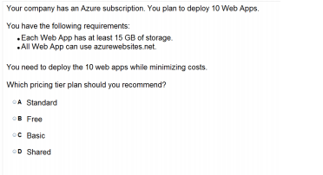

Slide 11
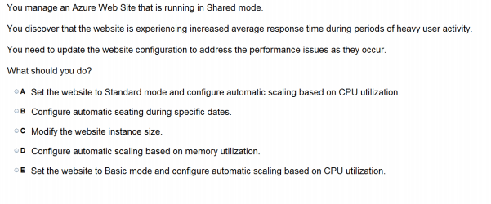

Slide 12
Explanation:
Scaling to Standard Plan expands the Capacity section to give the Instance Size and Instance Count options, and is also available in Basic mode. But The Edit Scale Settings for Schedule and Scale by Metric options is only in Standard.

Slide 13
Custom Domain & SSL Certificate

Slide 14
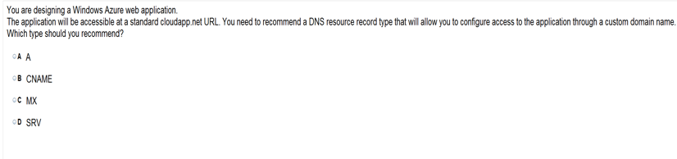

Slide 15
You create an Azure Active Directory (Azure AD)tenant named Tenant1 that has a domain name of tenant1.onmicrosoft.com. You need to add the contoso.com domain name to Tenant1. Which DNS record should you add to the contoso.com zone to be able to verify from Azure whether you own the contoso.comdomain?
A) standard alias (CNAME)
B) mail exchanger (MX)
C) host (AAAA)
D) signature (SIG)
E) A

Slide 16
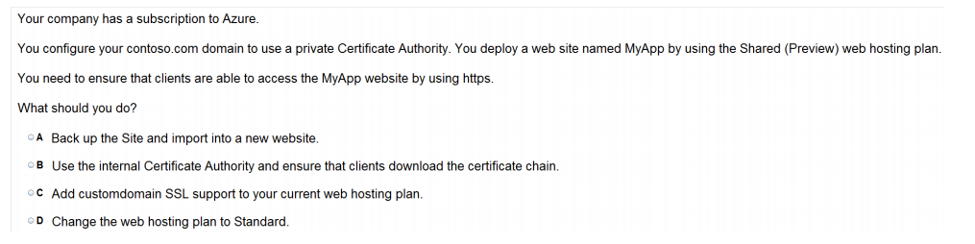

Slide 17
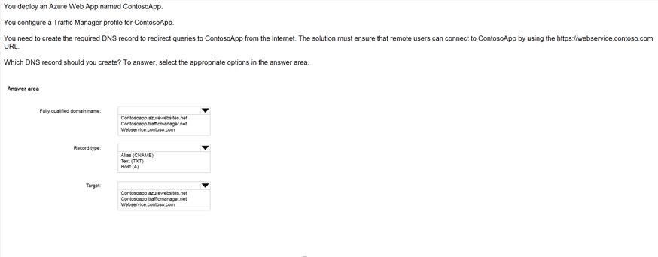
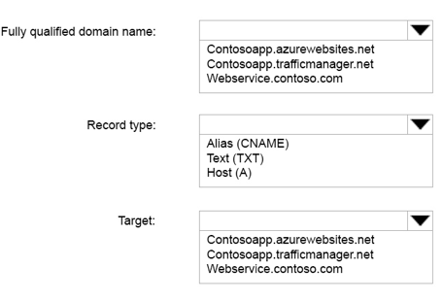
Ans =

Slide 18
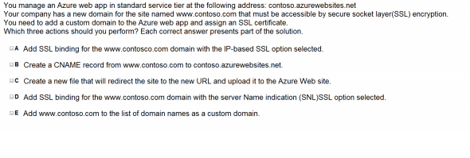

Slide 19
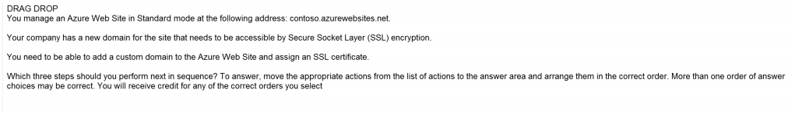
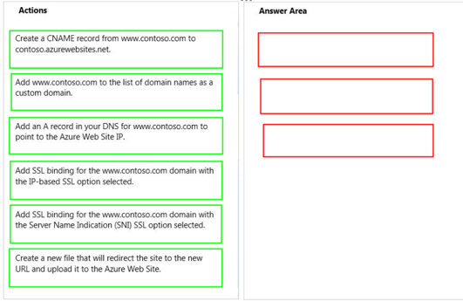
Ans =

Slide 20
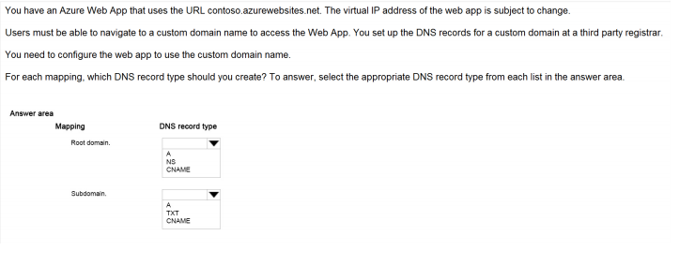
Show by Step Domain Mapping

Slide 21
Diagnostic

Slide 22
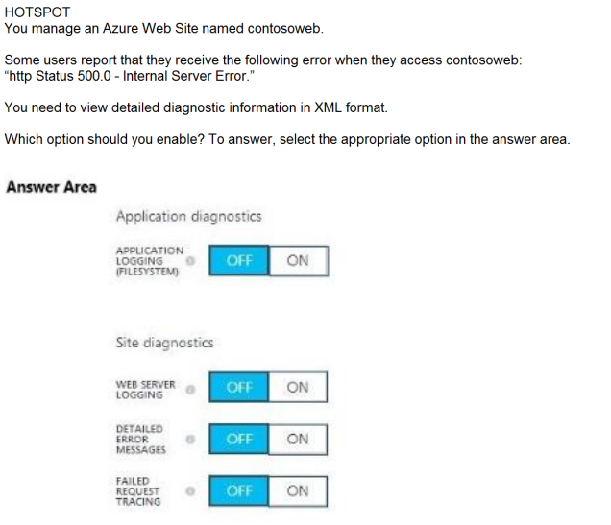
Ans = A

Slide 23
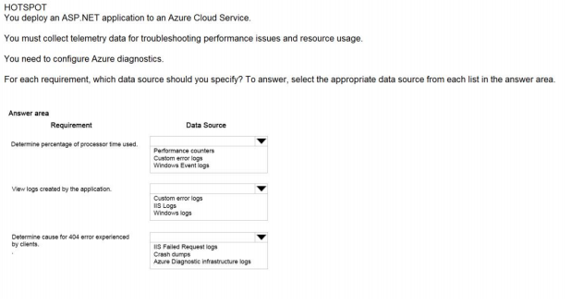

Slide 24
Analyse

Slide 25
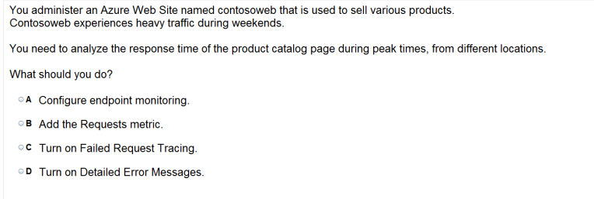

Slide 26
Monitoring

Slide 27
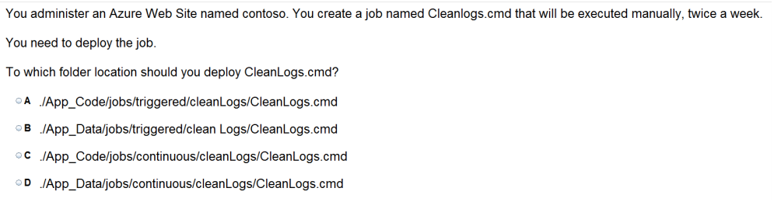

Slide 28
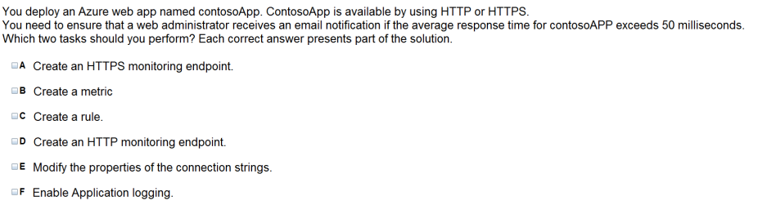

Slide 29
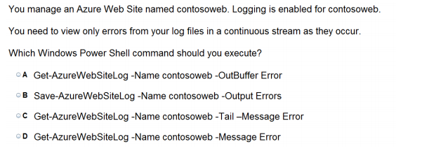

Slide 30
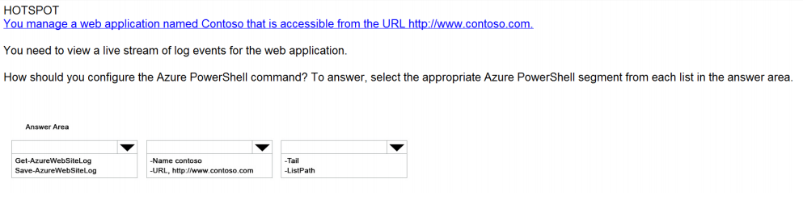
Ans =

Slide 31
Deployment Slot

Slide 32

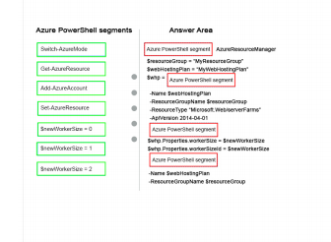
Ans =

Slide 33
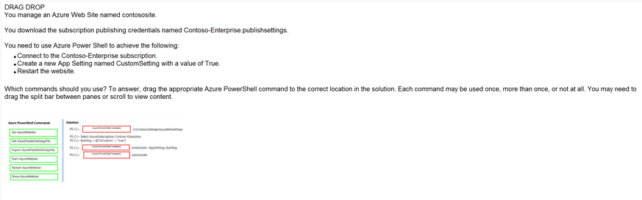
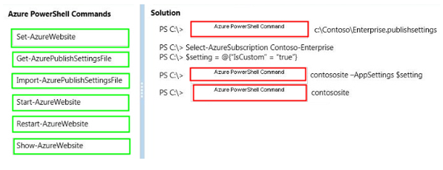
Ans =

Slide 34
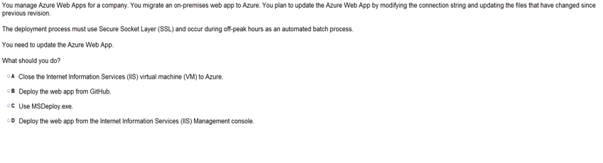

Slide 35
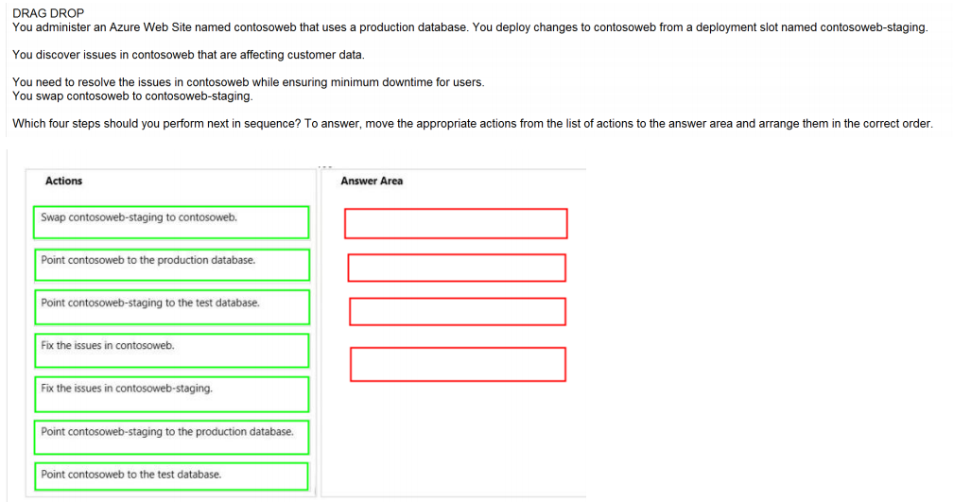
Ans =

Slide 36
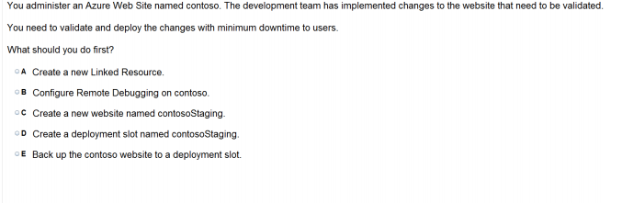

Slide 37
Cross Platform CLI tool ( Command line Interface)

Slide 38
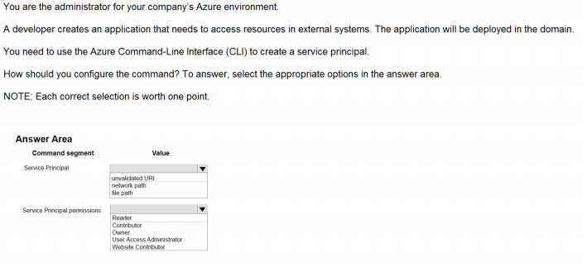

Slide 39
App Service Autentication

Slide 40
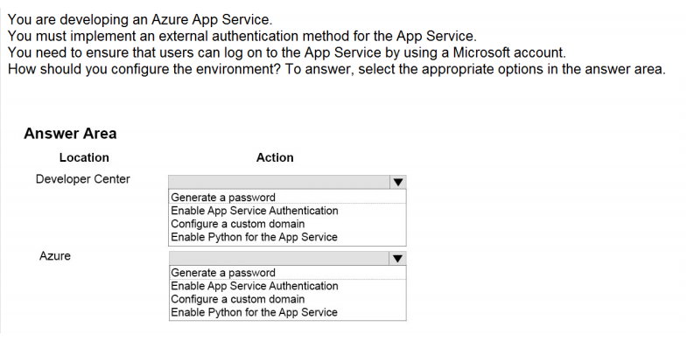
Ans =

Slide 41
Web Jobs

Slide 42
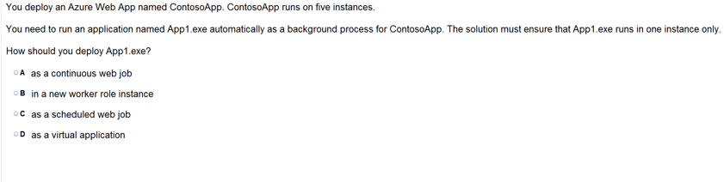

Slide 43
https://www.proprofs.com/quiz-school/story.php?title=mtg1mjywna99ud

